Slide 1

Phylogenetic Analysis of Type II Toxin-Antitoxin Systems in E.Coli
20
22
UCSC Microbiology & Environmental Toxicology
Manel Camps Lab
Nitya Jain
20
22

Slide 2
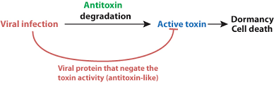
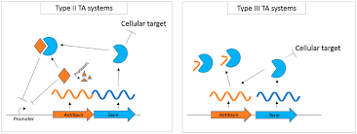
Biological Background
Plasmids are self-replicating extrachromosomal DNA that carry nonessential genes
Toxin-Antitoxin (TA) systems = maintenance gene for plasmids
This study specifically looks at Type II TA systems
Post-segregational killing mechanism → “plasmid addiction”
Unlikely to be their only function
Not much is known about the origin of TA systems and their evolutionary relationships & functional similarities
Multiple types need to be classified & annotated correctly
Notes:
Background - any relevant background to understand the proposed work (55 seconds)
Need to add figures

Slide 3
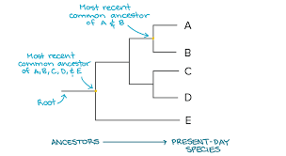
Computational Background
Phylogenetic trees = diagram that depicts the lines of evolutionary descent of genes from a common ancestor
Previous phylogenetic analyses’ aims → to find new TA systems to be annotated in NCBI
Sequence alignments = to compare related DNA/protein sequences
Most commonly used softwares are CLUSTALW and MUSCLE
Notes:
Background - any relevant background to understand the proposed work (55 seconds)
Need to add figures

Slide 4
Research Question
Genetic anomaly in NCBI dataset → Multiple TA systems are found on plasmids from the same family
Aim: perform a phylogenetic analysis for these TA systems to better understand the evolutionary relationships of toxins & antitoxins
Hypothesis: toxins are more closely related to each other than the antitoxins
Notes:
Background - any relevant background to understand the proposed work (55 seconds)
Need to add figures

Slide 5
Methods
Find genomes that have redundant TA systems
Filtering for duplicates & single antitoxin hits to reduce noise
Perform sequence alignment through MUSCLE for each family
Generate trees each family
Guide trees through MUSCLE (all type II)
Distance-based trees using UPGMA algorithm
Family specific trees through FastTree
Maximum Likelihood, for large alignments
Visualize & annotate trees through ITOL
Assigned colors using ITOL annotation templates and manual annotation
Based on PTU (plasmid taxonomic units) & clades
Notes:
Proposed work - a succinct description of what you plan to do (1 min)
Toxin & antitoxin to see if antitoxin is misclassified
Relationship of T & AT → one for toxin, one for antitoxin?
Multiple occurrences of the same toxin but different antitoxin in one genome https://bmcmicrobiol.biomedcentral.com/articles/10.1186/1471-2180-8-104#Sec8 old paper but could we use these methods?

Slide 6
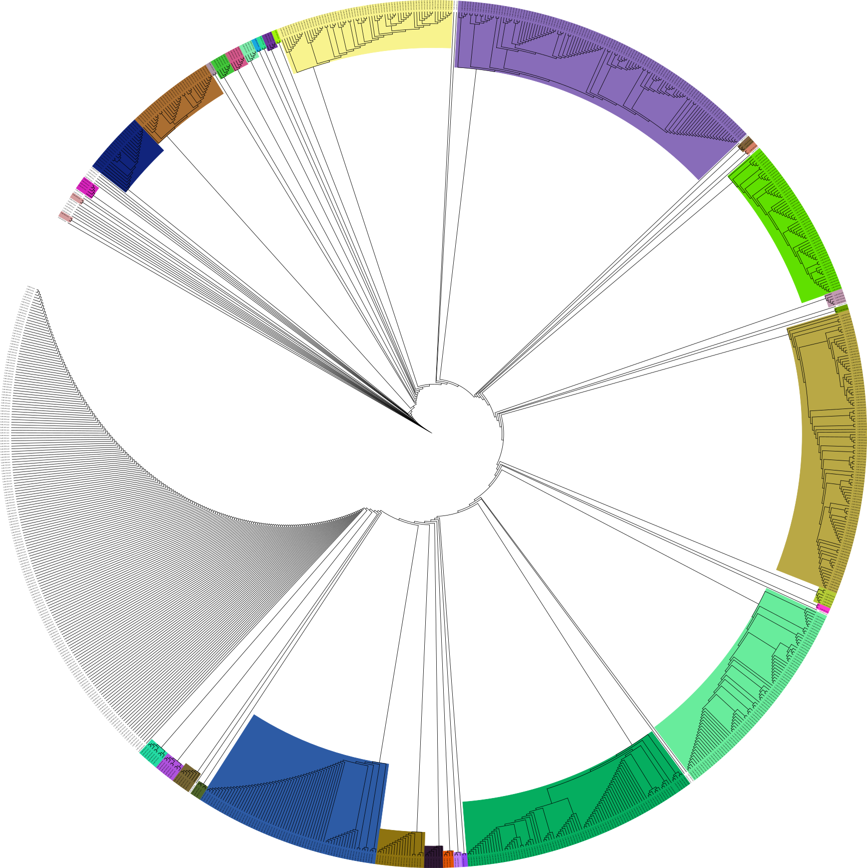
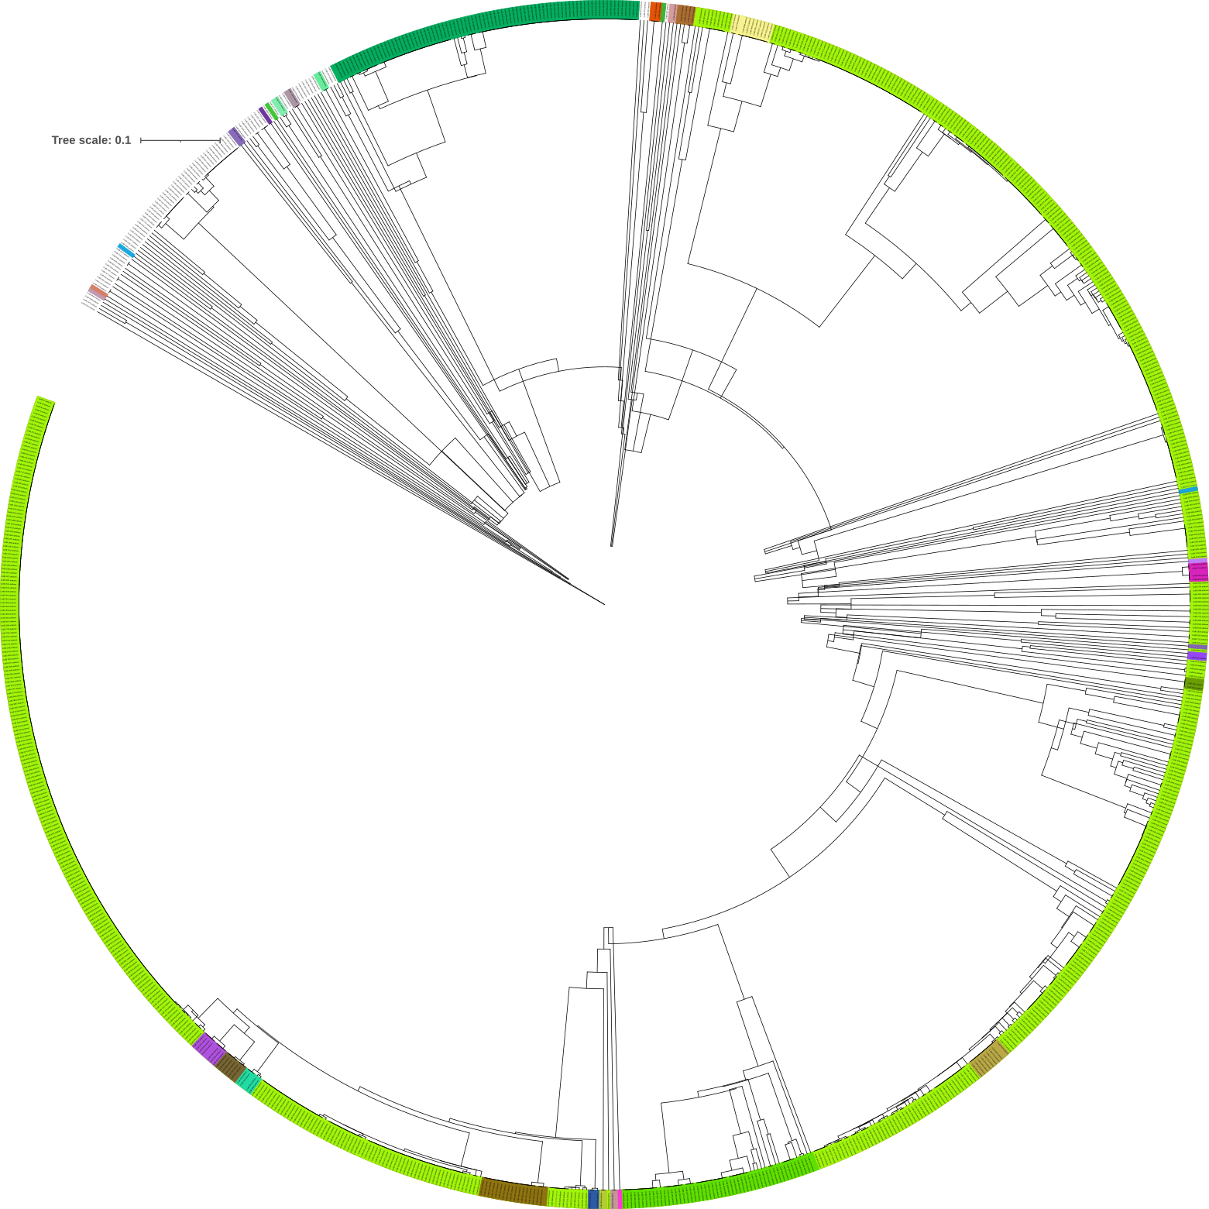
Circular, Type II
Toxins
Antitoxins

Slide 7
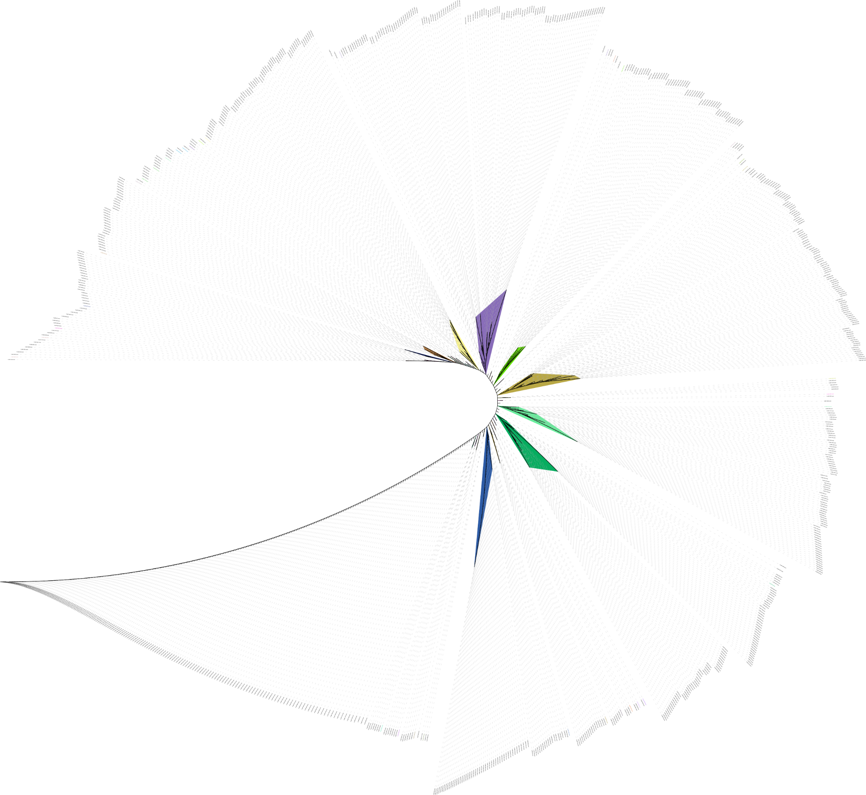
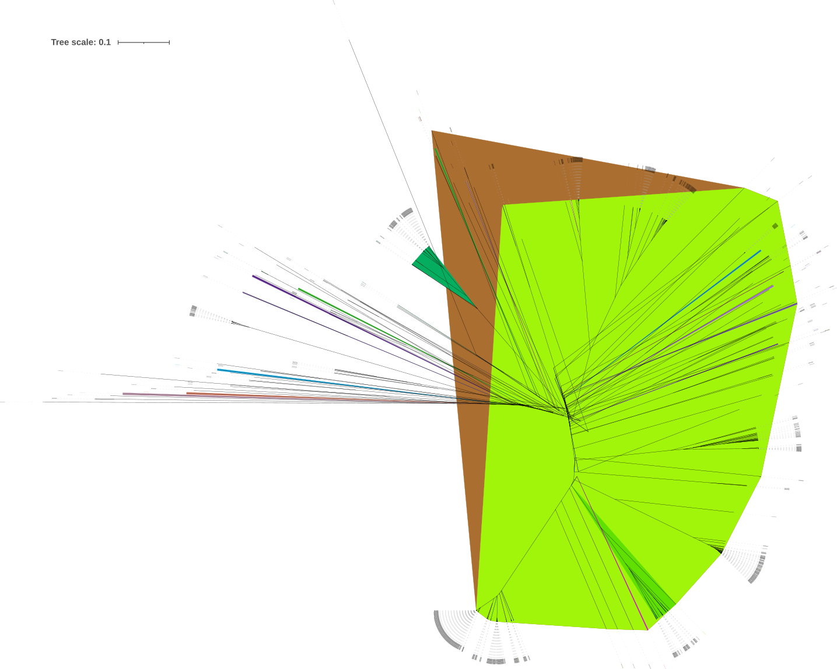
Unrooted, all Type II
Toxins
Antitoxins

Slide 8
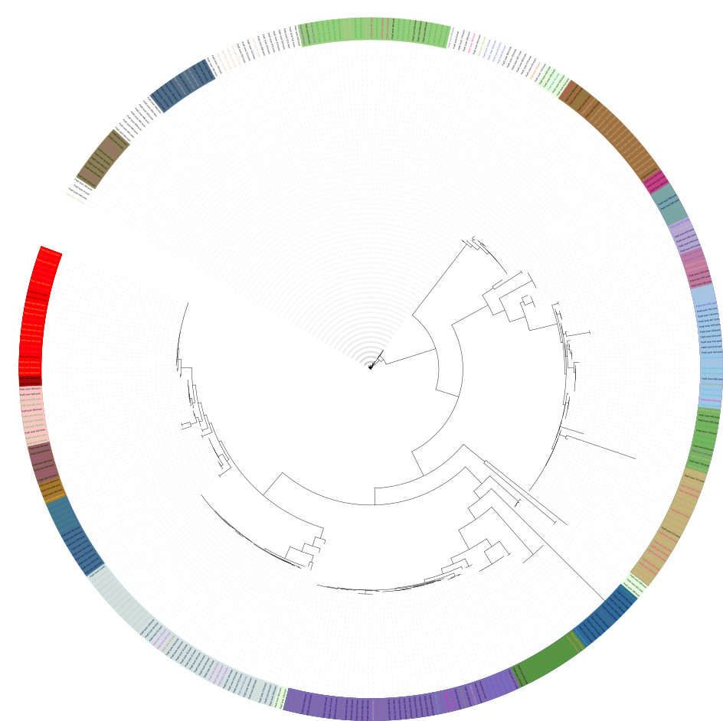
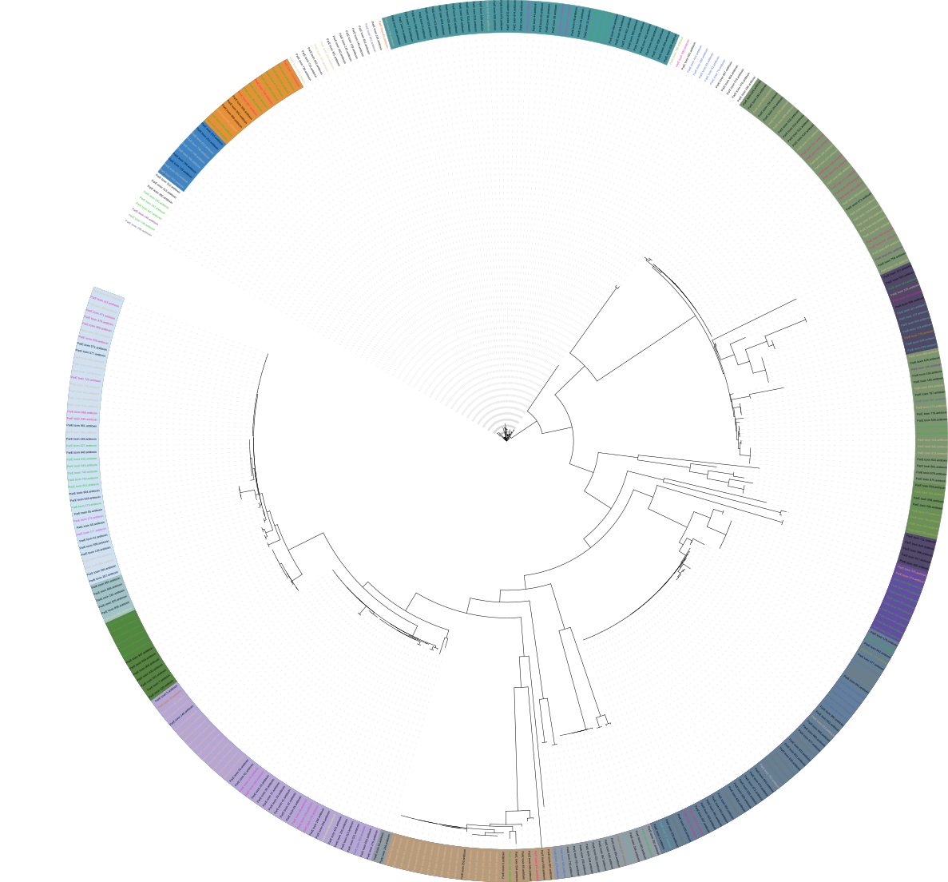
ParE Circular
Toxins
Antitoxins

Slide 9
Discussion
Phylogenies appeared to be quite different for toxins and antitoxins
Toxins are more closely related than the antitoxins
Future work
Highlight the subgroups based on conjugated & nonconjugated plasmids
Perform this analysis with the rest of the TA systems → patterns?
Alpha Fold for structural analysis
Use different phylogenetic tree methods & non-duplicated datasets as validation
Robinson-Foulds (RF) distance → distance between phylogenetic tree, quantitative analysis/validation

Slide 10

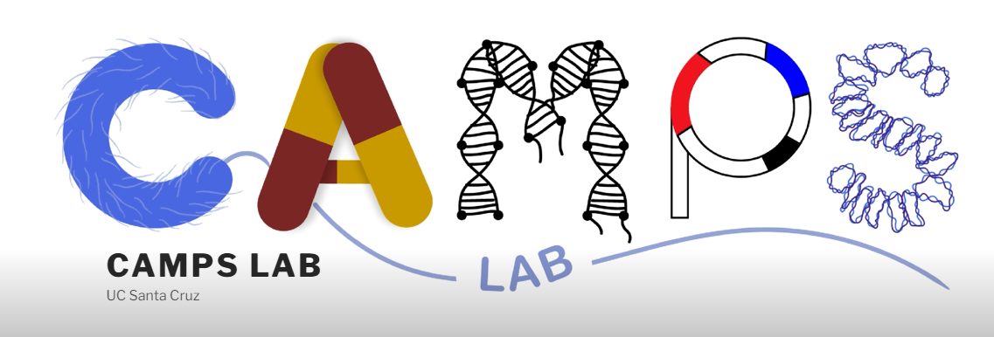
Contact Info
Acknowledgements:
Caison Warner, PhD Candidate METX
Manel Camps, Professor METX
Benedict Paten, Professor BMEB
UCSC Genomics Institute
Connect with me on LinkedIn!
njain14@ucsc.edu

